Slide 1
Introduction
Yao-Yuan Chuang

Slide 2
UNIX
Unix (officially trademarked as UNIX®) is a computer operating system originally developed in the 1960s and 1970s by a group of AT&T employees at Bell Labs including Ken Thompson, Dennis Ritchie and Douglas McIlroy. Today's Unix systems are split into various branches, developed over time by AT&T as well as various commercial vendors and non-profit organizations.
The present owner of the trademark UNIX® is The Open Group, an industry standards consortium. Only systems fully compliant with and certified to the Single UNIX Specification qualify as "UNIX®" (others are called "Unix system-like" or "Unix-like").
During the late 1970s and early 1980s, Unix's influence in academic circles led to large-scale adoption (particularly of the BSD variant, originating from the University of California, Berkeley) of Unix by commercial startups, the most notable of which is Sun Microsystems. Today, in addition to certified Unix systems, Unix-like operating systems such as Linux, Mac OS X and BSD derivatives are commonly encountered.

Slide 3
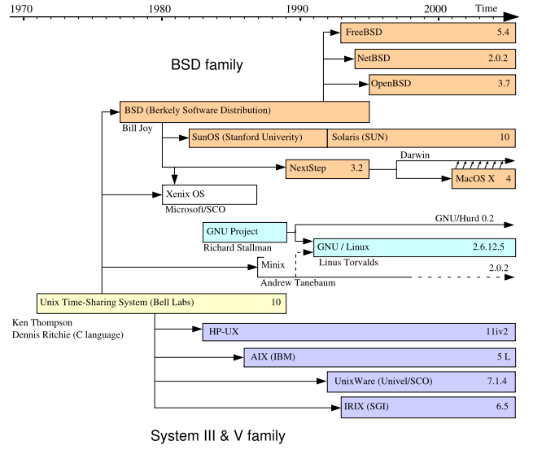
UNIX
(http://en.wikipedia/org/wiki/Unix)

Slide 4
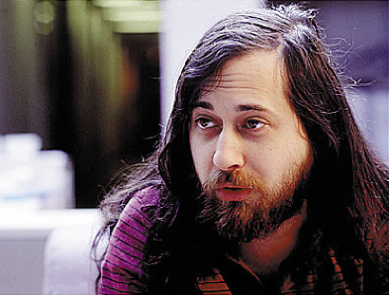

GNU
The GNU project was publicly announced by Richard Stallman.
GNU was to be a complete Unix-like operating system composed entirely of free software. Software development work began in January 1984. By the beginning of the 1990s, the project had produced or collected most of the necessary components of this system, including libraries, compilers, text editors, and a Unix shell.
Thus the GNU mid-level portions of the operating system were almost complete. The upper level could be supplied by the X Window System, but the lower level, which consisted of a kernel, device drivers, and daemons, was still mostly lacking. In 1990, the GNU project began developing the GNU Hurd kernel, based on the Mach microkernel.
(http://en.wikipedia/org/wiki/GNU)

Slide 5


Linux
Linus Torvalds, creator of the Linux kernel.
In 1991, work on the Linux kernel began by Linus Torvalds while attending the University of Helsinki. Torvalds originally created the Linux kernel as a non-commercial replacement for the Minix kernel; he later changed his original non-free license to the GPLv2, which differed primarily in that it also allowed for commercial redistribution.
Although dependent on the Minix userspace at first, work from both Linux kernel developers and the GNU project allowed Linux to work with GNU components. Thus Linux filled the last major gap in running a complete, fully functional operating system built from free software.
(http://en.wikipedia/org/wiki/Linux)

Slide 6
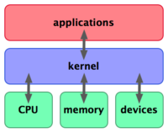
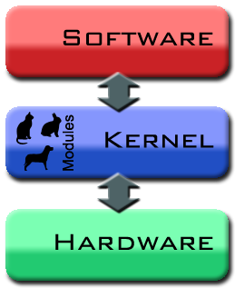
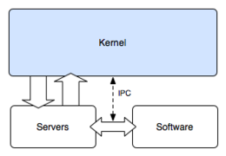
Kernel
In computing, the kernel is the central component of most computer operating systems (OSs). Its responsibilities include managing the system's resources and the communication between hardware and software components.
As a basic component of an operating system, a kernel provides the lowest-level abstraction layer for the resources (especially memory, processors and I/O devices) that applications must control to perform their function. It typically makes these facilities available to application processes through inter-process communication mechanisms and system calls.
While monolithic kernels will try to achieve these goals by executing all the code in the same address space to increase the performance of the system, microkernels run most of their services in user space, aiming to improve maintainability and modularity of the codebase.

Slide 7
Linux Distribution
A Linux distribution, often simply distribution or distro, is a member of the Linux family of Unix-like operating systems comprised of the Linux kernel, the non-kernel parts of the GNU operating system, and assorted other software. Linux distributions take a variety of forms, from fully-featured desktop and server operating systems to minimal environments (typically for use in embedded systems, or for booting from a floppy).
CentOS • Debian • Fedora • Gentoo • Knoppix • Mandriva Linux • Red Hat Enterprise Linux • Slackware • SUSE Linux • Ubuntu • more… •

Slide 8
Unix Shell
A Unix shell, also called "the command line", provides the traditional user interface for the Unix operating system and for Unix-like systems.
bash – Bourne Again SHell, (mostly) sh-compatible and csh-compatible, standard shell on Linux systems and Mac OS X.
csh – C shell. Written by Bill Joy for BSD systems.
ksh – Korn shell, standard shell on many proprietary Unix systems, powerful successor to the Unix Bourne shell (sh), written by David Korn,
rc – originally written for Plan 9.
sh – Bourne shell, only shell present on all UNIX and Unix-like systems, written by Stephen Bourne for Version 7 Unix.
tcsh – TENEX C shell, standard shell on BSD systems.
zsh – Z shell.
(http://en.wikipedia/org/wiki/Unix_shell)

Slide 9
Bash
Bash is a Unix shell written for the GNU Project. The name of the actual executable is bash. Its name is an acronym for Bourne-again shell, a pun ('Bourne again' / 'born again') on the name of the Bourne shell (sh), an early and important Unix shell written by Stephen Bourne and distributed with Version 7 Unix circa 1978. Bash was created in 1987 by Brian Fox. In 1990 Chet Ramey became the primary maintainer.
Bash is the default shell on most Linux systems as well as on Mac OS X and it can be run on most Unix-like operating systems. It has also been ported to Microsoft Windows within the Cygwin POSIX emulation environment for Windows and to MS-DOS by the DJGPP project. Released under the GNU General Public License, Bash is free software.
(http://en.wikipedia/org/wiki/Bash)

Slide 10
General User Commands
dd – Convert and copy a file (Disk Dump)
dirname – Strip non-directory suffixes from a path
echo – Print to standard output
env – Show environment variables; run a program with altered environment variables
file (or stat) – Determine the type of a file
nohup – Run a command with immunity to hangups outputting to non-tty
sh – The Bourne shell, the standard Unix shell
uptime – Print how long the system has been running
(http://en.wikipedia/org/wiki/Linux_commands)

Slide 11
Processes and tasks management
anacron – Periodic command scheduler
at – Single-time command scheduler
chroot – Change the system root directory for all child processes
cron – Periodic command scheduler
crontab – Crontab file editor
daemonic – Interface to daemon init scripts
htop – Interactive ncurses-based process viewer that allows scrolling to see all processes and their full command lines
kill – Send a signal to process, or terminate a process (by PID)
killall – Terminate all processes (in GNU/Linux, it's kill by name)
(http://en.wikipedia/org/wiki/Linux_commands)

Slide 12
Processes and tasks management
nice – Alter priorities for processes
pgrep – Find PIDs of processes by name
pidof – GNU/Linux equivalent of pgrep
pkill – Send a signal to process, or terminate a process (by name). Equivalent to Linux killall
ps – Report process status
renice – Alter the priorities of an already running process
sleep – Delay for specified time
time – Time a command
timex – Time process shell execution, measure process data and system activity
top – Produce a dynamic list of all resident processes
wait – Wait for the specified process
(http://en.wikipedia/org/wiki/Linux_commands)

Slide 13
User management and support
chsh – Change user shell
finger – Get details about user
id – Print real/effective UIDs/GIDs
last – show listing of last logged in users
lastlog – show last log in information for users
locale – Get locale specific information
localedef – Compile locale definitions
logname – Print user's login name
man – Manual browser
mesg – Control write access to your terminal
passwd – Change user password
(http://en.wikipedia/org/wiki/Linux_commands)

Slide 14
User management and support
su – Start a new process (defaults to shell) as a different user (defaults to root)
sudo – execute a command as a different user.
users – Show who is logged on (only users names)
w – Show logged-in users and their current tasks
whatis – command description from whatis database
whereis – locates the command's binary and manual pages associated with it
which (Unix) – locates where a command is executed from
who – Show who is logged on (with some details)
write – Send a message to another user
(http://en.wikipedia/org/wiki/Linux_commands)

Slide 15
Filesystem Utilities
info – The GNU alternative to man
man – The standard unix documentation system
chattr – Change file attributes on a Linux second extended file system
chgrp – Change the group of a file or directory
chmod – Change the permissions of a file or directory
chown – Change the owner of a file or directory
cd – Change to another directory location
cp – Copy a file or directory to another location

Slide 16
Filesystem Utilities
df – Report disk space
dircmp – Compare contents of files between two directories
du – Calculate used disk space
fdupes – Find or remove duplicate files within a directory
find – Search for files through a directory hierarchy
fsck – Filesystem check
ln – Link one file/directory to another
ls – List directory contents
lsattr – List file attributes on a Linux second extended file system
lsof – list open files

Slide 17
Filesystem Utilities
mkdir – Make a directory
mkfifo – Make a named pipe
mount – Mount a filesystem
mv – Move or rename a file or directory
pwd – Print the current working directory
rm – Delete a file or directory tree
readlink – Display value of a symbolic link, or display canonical path for a file
rmdir – Delete an empty directory
touch – Create a new file or update its modification time
tree – Print a depth-indented tree of a given directory
unlink – System call to remove a file or directory

Slide 18
Text Processing
awk – A pattern scanning and processing language
banner – Creates ascii art version of an input string for printing large banners
cat – Concatenate files to standard output
cksum – Print the CRC checksum and bytecount of a file (see also MD5)
cmp – Compare two files byte for byte
cut – Remove sections from each line of a file or standard input
diff – Compare two text files line by line
egrep – Extended pattern matching (synonym for "grep -E")
fgrep – Simplified pattern matching (synonym for "grep -F")
fold – Wrap each input line to fit within the given width
grep – Print lines matching a pattern
head – Output the first parts of a file
iconv – Convert the encoding of the specified files
join – Join lines of two files on a common field
less – Improved more-like text pager

Slide 19
Text Processing
more – Pager
nroff – Fixed-width (non-typesetter) version of the standard Unix typesetting system
patch – Change files based on a patch file
sed – Stream EDitor
sort – Sort lines of text files
split – Split a file into pieces
tail – Output the tail end of files
tee – Read from standard input, write to standard output and files
uudecode – Decodes a binary file that was used for transmission using electronic mail
uuencode – Encodes a binary file for transmission using electronic mail
wc – Word/line/byte count

Slide 20
Package Management
apt – Front-end for dpkg or rpm
debconf – Debian package configuration management system
dpkg – The Debian package manager
drakconf – Front-end configuration utility for Mandriva Linux
emerge – A frontend to portage
pacman – A package manager used primarily by Arch Linux
portage – The Gentoo Linux package manager
rpm – Originally the package manager for Red Hat Linux, now used by several distributions including Mandriva Linux
Synaptic – GTK+ frontend for the apt package manager. Primarily used by Ubuntu Linux, Debian Sarge, and other Debian-based systems; but usable on any system using apt.
urpmi – Front-end to rpm, used by Mandriva Linux
YaST - System management utility mainly used by SuSE
yum - Front-end for rpm, used by Fedora

Slide 21
Unix command line
File and file system management: cat | cd | chmod | chown | chgrp | cp | du | df | file | fsck | ln | ls | lsof | mkdir | mount | mv | pwd | rm | rmdir | split | touch
Process management: at | chroot | crontab | kill | killall | nice | pgrep | pidof | pkill | ps | sleep | time | top | wait | watch
User Management/Environment:env | finger | id | mesg | passwd | su | sudo | uname | uptime | w | wall | who | whoami | write
Text processing:awk | cut | diff | ex | head | iconv | join | less | more | paste | sed | sort | tail | tr | uniq | wc | xargs
Shell programming:echo | expr | printf | unset
Printing:lp
Communications:
inetd | netstat | ping | rlogin | traceroute
Searching:
find | grep | strings
Miscellaneous:
banner | bc | cal | man | size | yes

